Slide 1
ETL

Slide 2
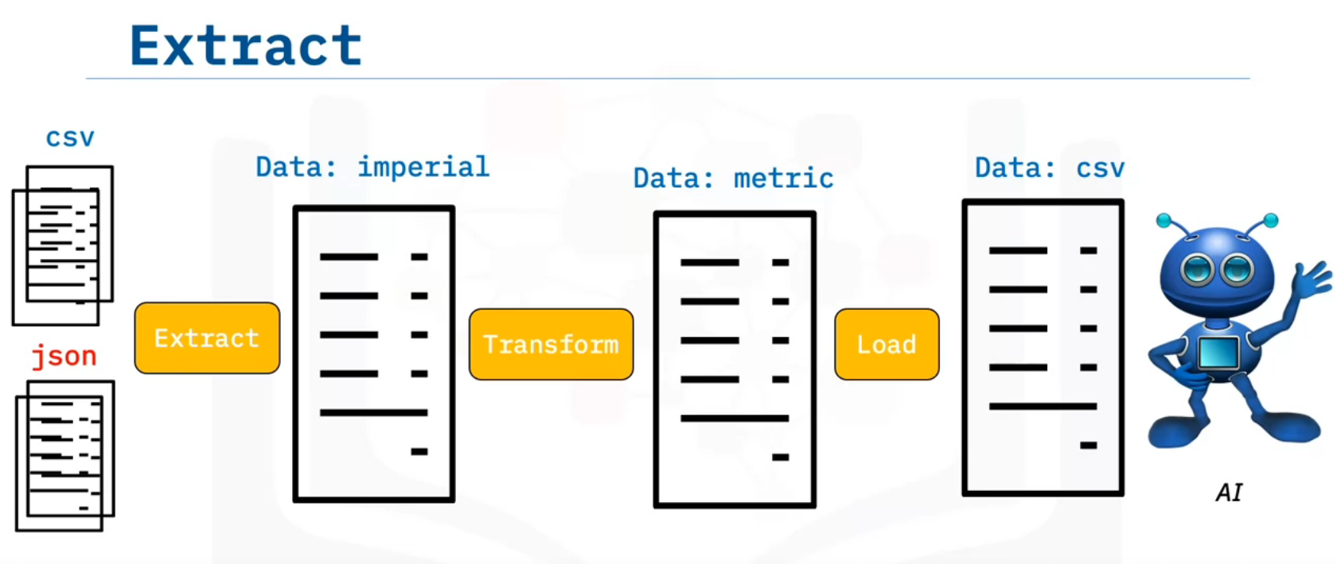
ETL is a type of batch processing called Extract, Transform and Load.
It is the process of extracting large amounts of data from multiple sources and formats and transforming it into one specific format before loading it into a database or target file (Source to Sink).
Some of your data is in CSV format, the other data is JSON files.
You need to Extract all this data into one file so the AI can read it.
Your data is in imperial but the AI uses metric units so you must transform it.
The AI only reads CSV data in one big file, so you need to load The data as CSV.

Slide 3
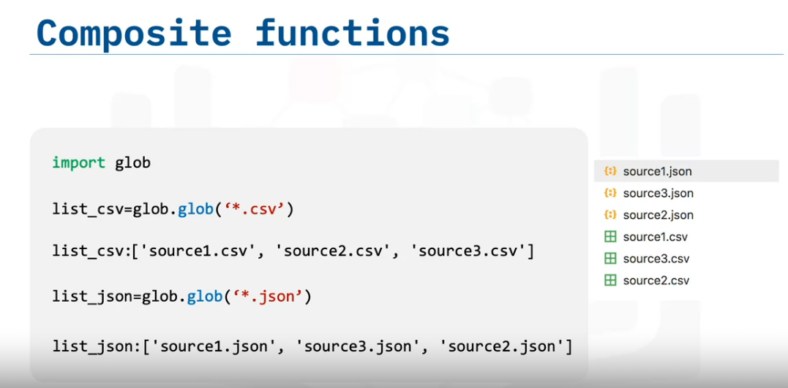
glob function, from the glob module. The input is the file extension and the output is a list of files with that particular extension.
Consider the list of .json and .csv files. The input is the glob file extension preceded by a star and a Dot. The output is a list of .csv files.
We can do the same for .json files. We can write a file to extract CSV of names, height, and weight.
The input is the file name of the .csv file, the result is a data frame. We can do the same for JSON formats.
The input is the name of the .json file, the output is a data frame.

Slide 4
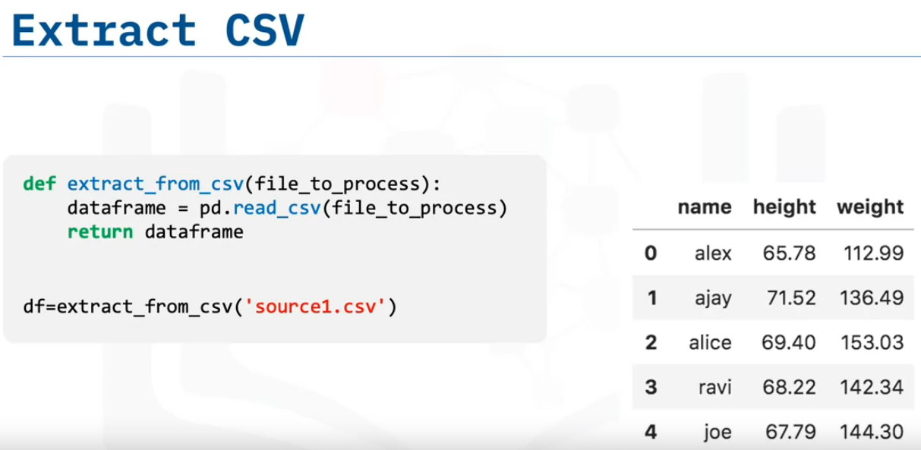
We can write a file to extract CSV of names, height, and weight.
The input is the file name of the .csv file, the result is a data frame.
We can do the same for JSON formats.

Slide 5
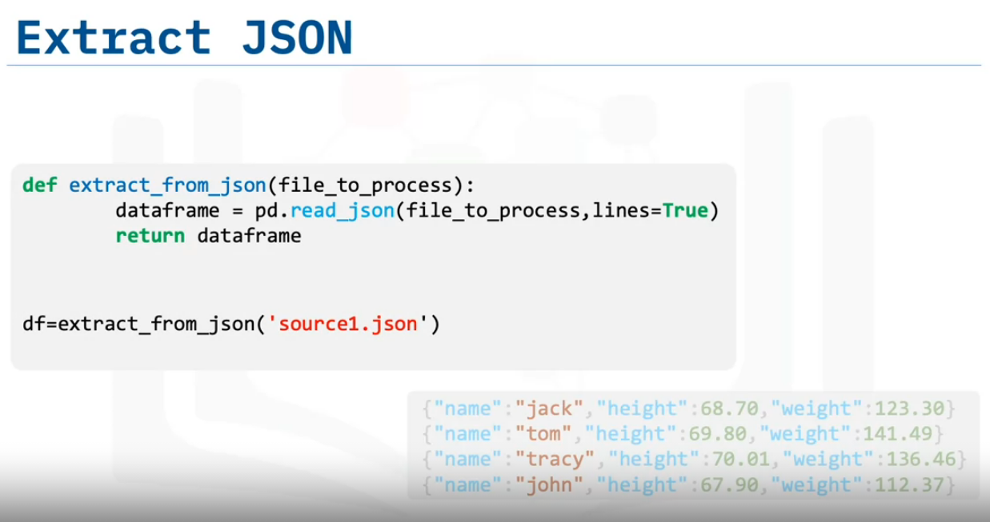

Slide 6
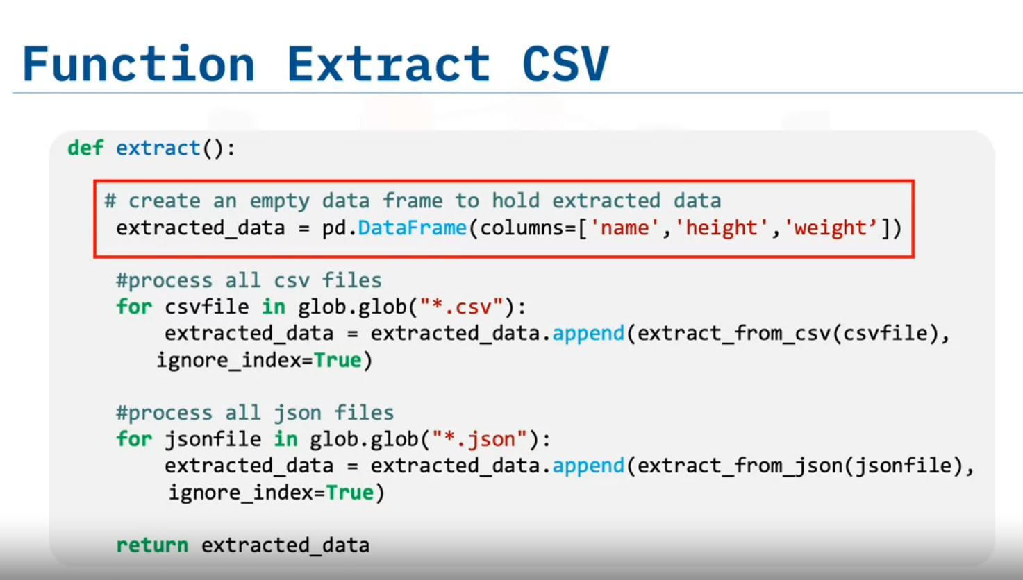
Appends data from all CSV files one after another in the form of Dataframe
The EXTRACT Function extract will extract large amounts of data from multiple sources in batches.

Slide 7
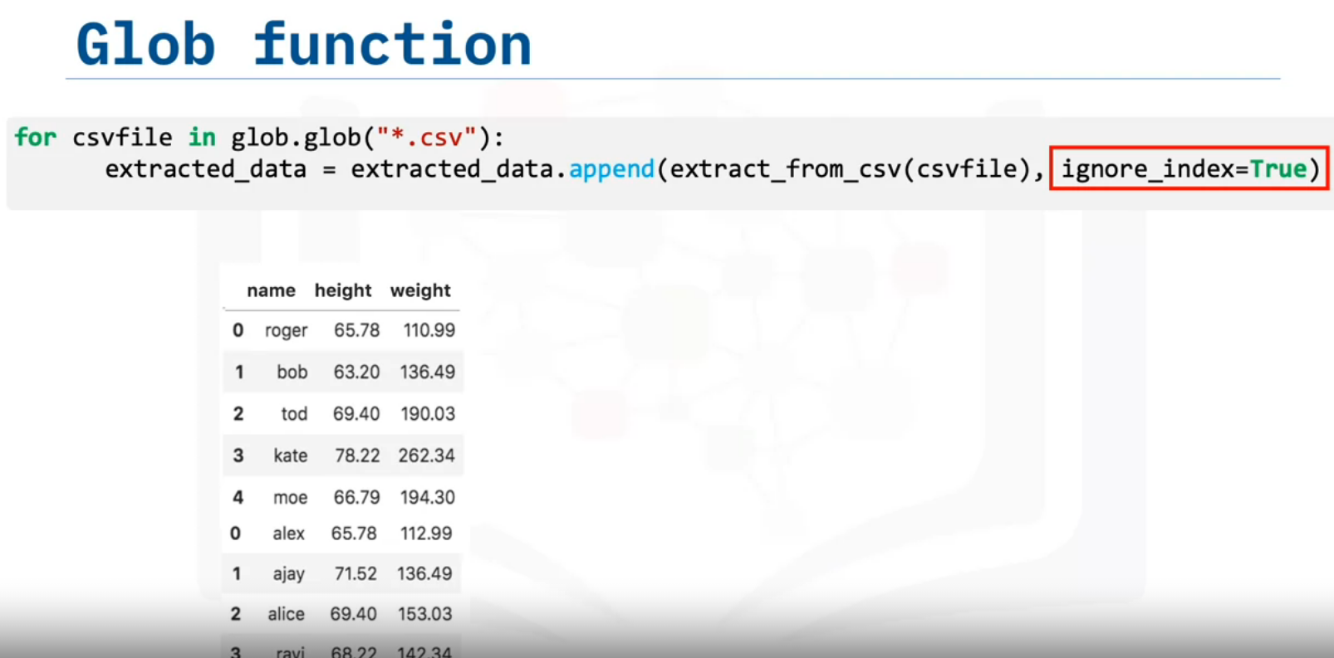
Setting, Ignore_index = True will form dataframe from all the data from different CSV files without considering index numbers.

Slide 8
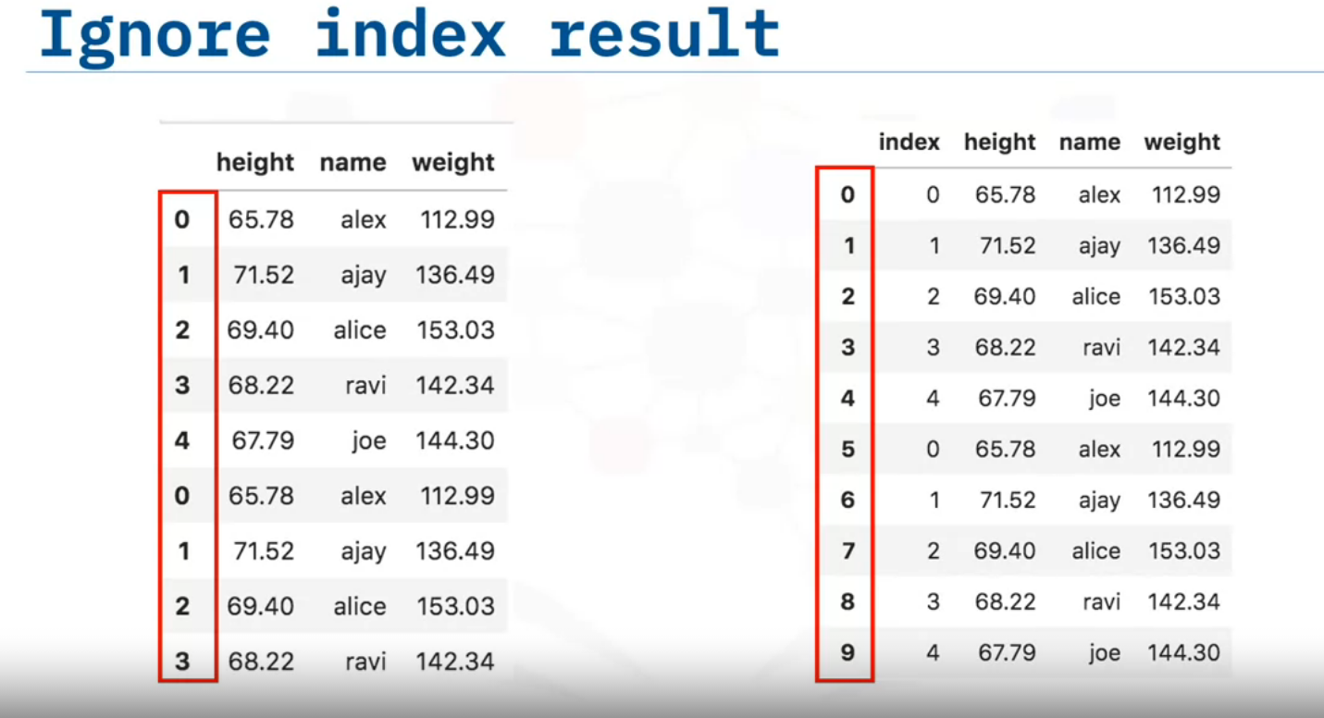
If ignor_index= False/Not True
If we did not set the parameter “ignore_index” to true, then the index of the data frame
“extracted_data” would be the same as the row Number of the original file.
If ignor_index = True
If we set the “ignore index” to true, then the order of each row would be the same
as the order the row was appended to the data frame.

Slide 9
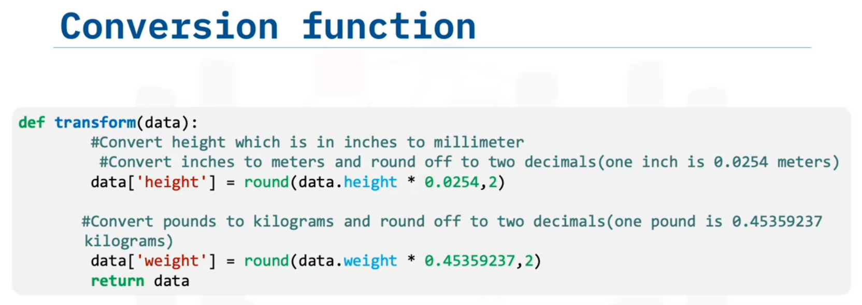
Transformation

Slide 10
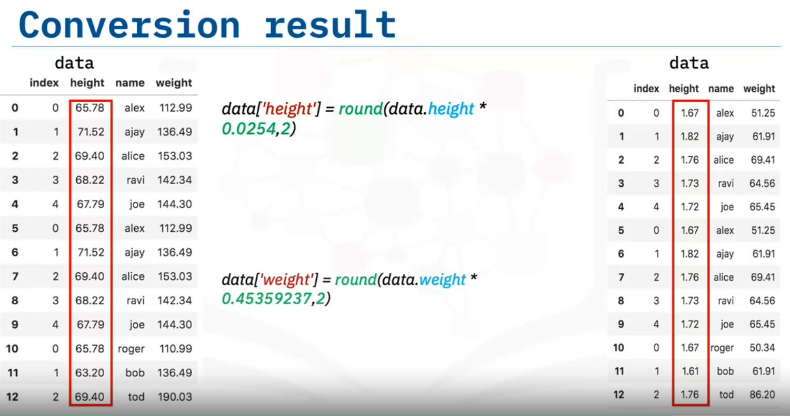
Transforming height from inched to millimeter

Slide 11
Loading & Lodging

Slide 12
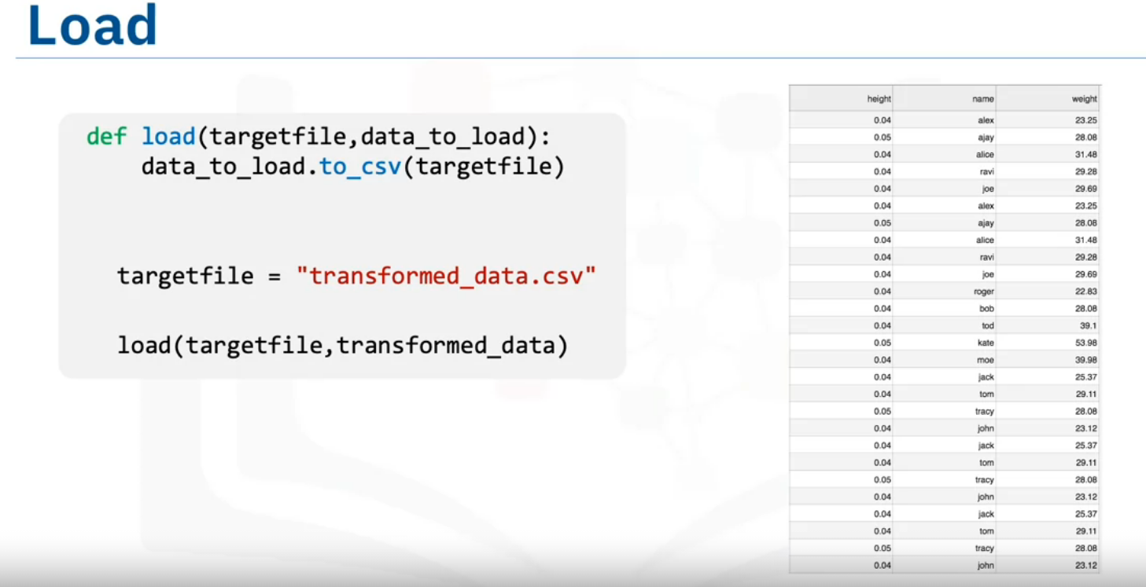
Saving/Loading all the extracted and transformed data into ‘CSV’ file for further Loading purpose/Batch processing.

Slide 13
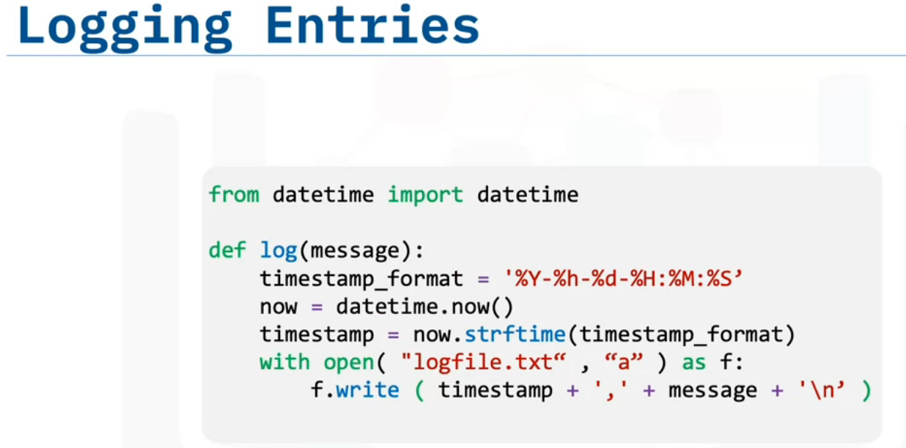
Define Timestamp_format to define date & time.
NOW will capture the current time by calling datetime
All the data_time entries will be appended with the help of with open & write

Slide 14
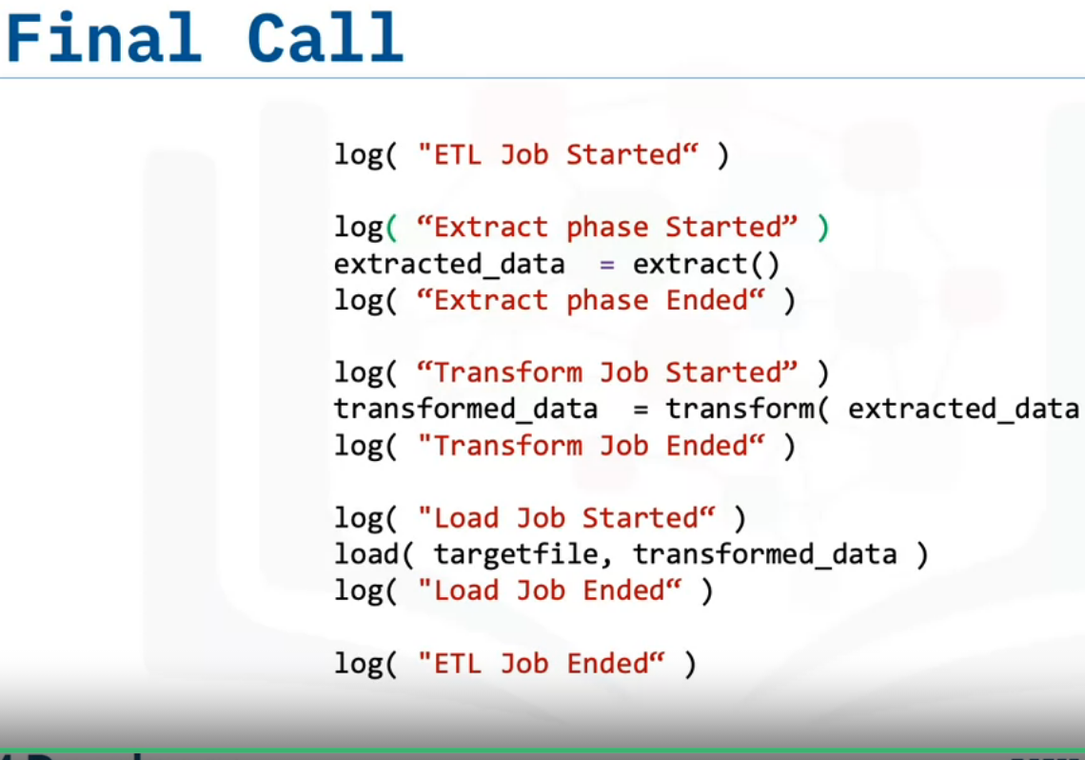
At the end ,we need to call all of the functions.
EXTRACT
TRANSFORM
LOAD

